Slide 1
Rule of the Week

Slide 2
13.2 Procedures for taking a free push, centre pass and putting the ball back into play after it has been outside the pitch:
b opponents must be at least 3 metres from the ball.
If an opponent is within 3 metres of the ball they must not interfere with the taking of the free push or must not play or attempt to play the ball. If this player is not playing the ball, attempting to play the ball or influencing play, the free push need not be delayed.

Slide 3
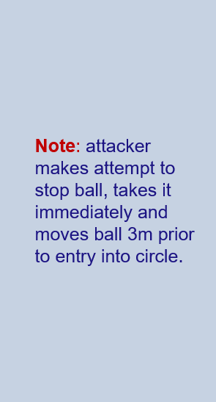
Managing 3m

Slide 4
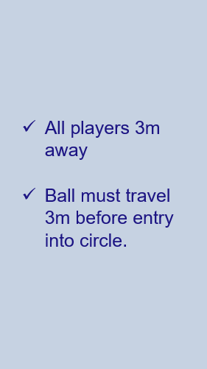
Managing 3m

