Slide 1
Rule of the Week

Slide 2
9.10 Players must not play the ball when it is in the air except that a player from the team which did not put the ball in the air may stop it.
If the ball is in the air as a result of a legitimate shot at goal which has rebounded from the goalkeeper, defender or from the goal-post or cross-bar, the ball may be stopped by a player of either team.

Slide 3
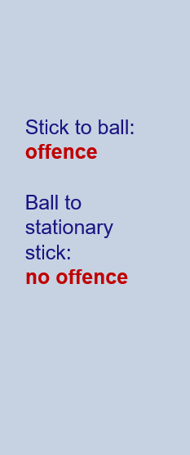
Playing Ball in Air

Slide 4
Playing Ball in Air

