Slide 1
Rule of the Week

Slide 2
9.9 Players must not raise the ball off the pitch except for a shot at goal.
It is not an offence if the ball rises unintentionally off the pitch by less than 100 mm unless an opponent is within playing distance of the ball.

Slide 3
Umpires
 Aim for top quality technical decisions and consistency.
 Make sure who gained advantage or player disadvantage.
 Consideration of within playing distance, versus could the defender play the ball legally.
Be consistent across the whole pitch, no personal interpretations at halfway line or in the circle.
 Early judgement.

Slide 4
Raised Ball

Slide 5
Raised Ball

Slide 6
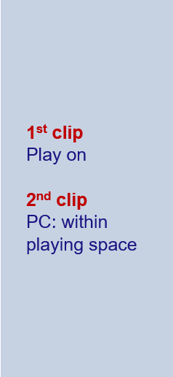
Raised Ball – Playing Distance

