Slide 1
Rule of the Week

Slide 2
9.14 Players must not tackle unless in a position to play the ball without body contact.
Reckless play, such as sliding tackles and other overly physical challenges by field players, which take an opponent to ground and which have the potential to cause injury should attract appropriate match and personal penalties.

Slide 3
Umpires
 Encourage contests – let the game develop – be sure before penalising.
 Be strict on the breaking down of play & intentional ‘stopping tackles’.
 Do not react to noise in tackle – watch the direction of the ball.
 Do not penalise just because the tackler appears to be in a seemingly impossible position from which to make a legal tackle.
 A sliding tackle which takes down a player is a high risk, high penalty action (yellow card 4 minutes).

Slide 4
Stick should be flat on the floor

Slide 5
Deliberate Breakdown

Slide 6
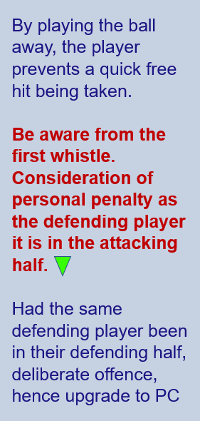
Deliberate Breakdown

