Slide 1
Rule of the Week

Slide 2
9.19 Players must not trap or hold the ball against the side-boards.
Players must not trap or hold the ball against the side-boards. A player in possession of the ball may not be ‘trapped’ either in the corner of the pitch or against the side boards by opponents with their sticks flat on the floor. Opponents must leave an outlet of reasonable size through which the ball may be played.

Slide 3
9.19 Players must not trap or hold the ball against the side-boards.
Umpires should recognise and interrupt play, with a bully re-start, when the ball is either trapped between players’ sticks or becomes unintentionally trapped against the side boards.
Repeated instances of players trapping or holding the ball against the side-boards should be viewed as an intentional offence and penalised accordingly.

Slide 4
9.19 Players must not trap or hold the ball against the side-boards.
Similarly, players who deliberately aim to trap the ball between their and an opponent’s stick should be penalised and not rewarded with a bully.

Slide 5
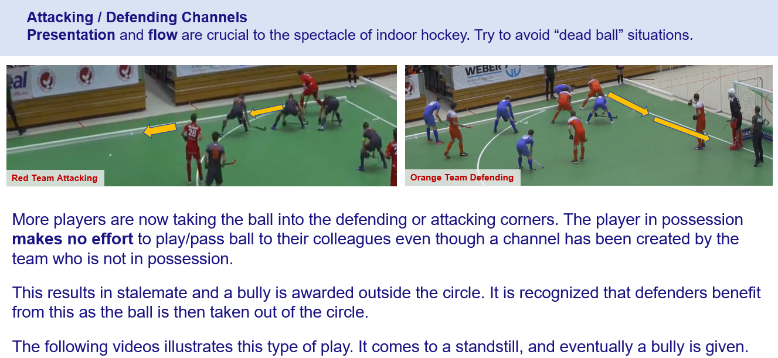
Trapping - Channels

Slide 6
Trapping - Channels

Slide 7
Trapping - Channels

Slide 8
Trapping - Channels

Slide 9
Trapping - Channels
No Outlet = Penalty Corner

