Slide 1
Rule of the Week

Slide 2
9.12 Field players must not play the ball while lying on the pitch or with a knee, arm or hand on the pitch, other than the hand holding the stick.

Slide 3
Hand / Body on Pitch

Slide 4
Uses Right Hand for Balance

Slide 5
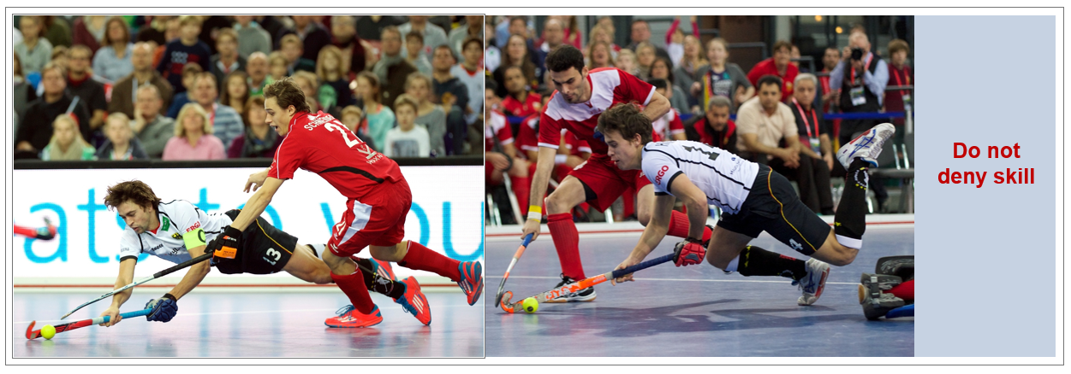
Hand / Body on Pitch

