Slide 1
Rule of the Week

Slide 2
2.3 Control
(c) It is not acceptable for players to abuse opponents, umpires or other technical officials verbally or through body language and attitude. Umpires must deal firmly with abuse of this sort and in appropriate circumstances issue a caution, or a temporary (green and yellow cards) or permanent (red card) suspension. Cautions and suspensions can be given in isolation or in combination with another penalty.

Slide 3
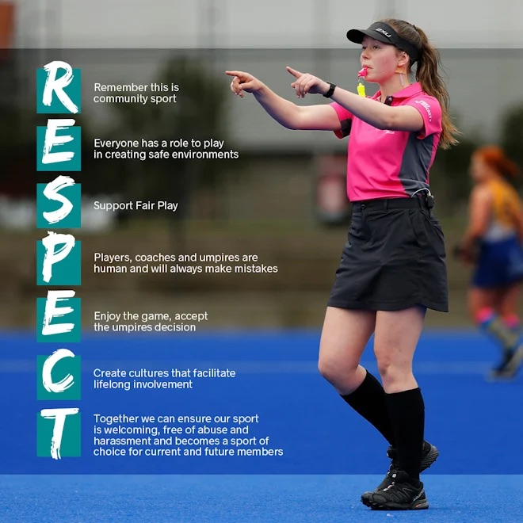

Slide 4
I AM YOUR UMPIRE TODAY...
On most occasions, I will be a school child / student, not an adult.
Some decisions might be against you - it's not a conspiracy.
Don't judge me like an experienced World Panel umpire.
There will be decisions I get wrong.
I am learning.
I love this game and I want your son or daughter to love this game.
Remember to thank them and show your respect.
We all have a part to play!
NO RESPECT • NO UMPIRES • NO GAME

