Slide 1




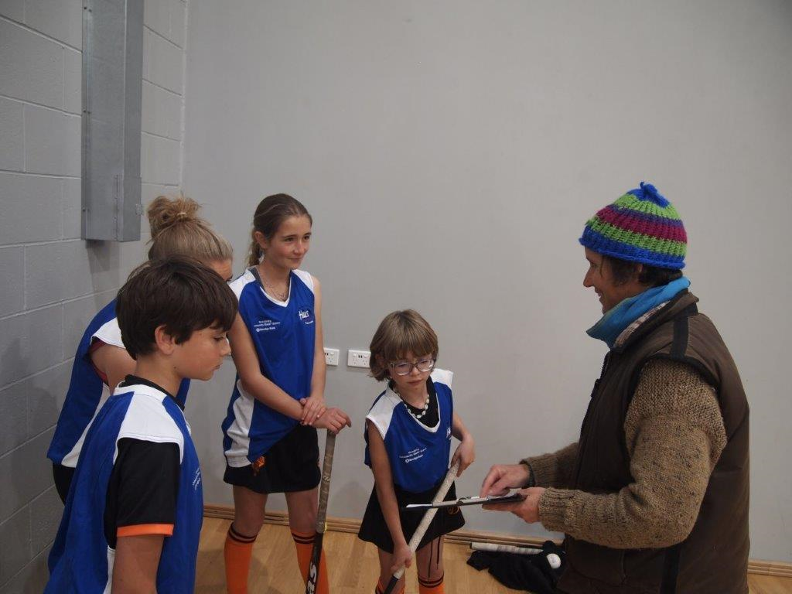
Indoor Hockey
Coaches’ Briefing

Slide 2
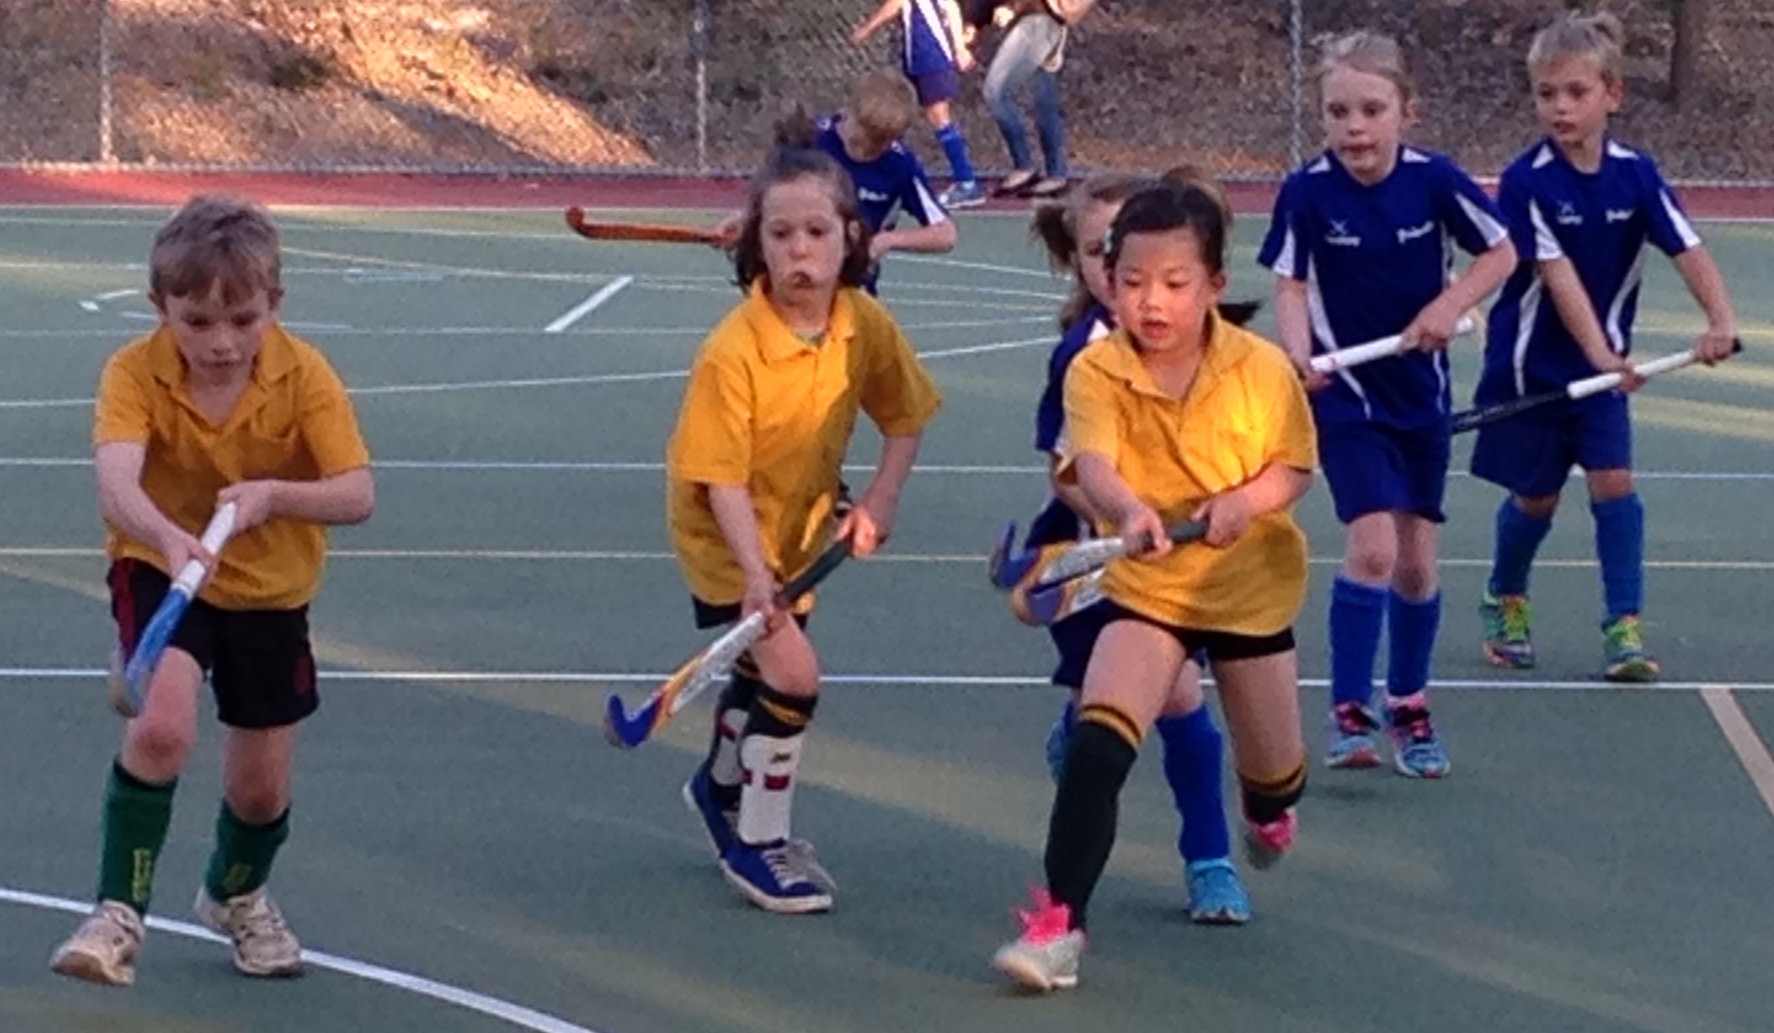
Welcome
UMPIRES
COACHES
COMMITTEE

Slide 3
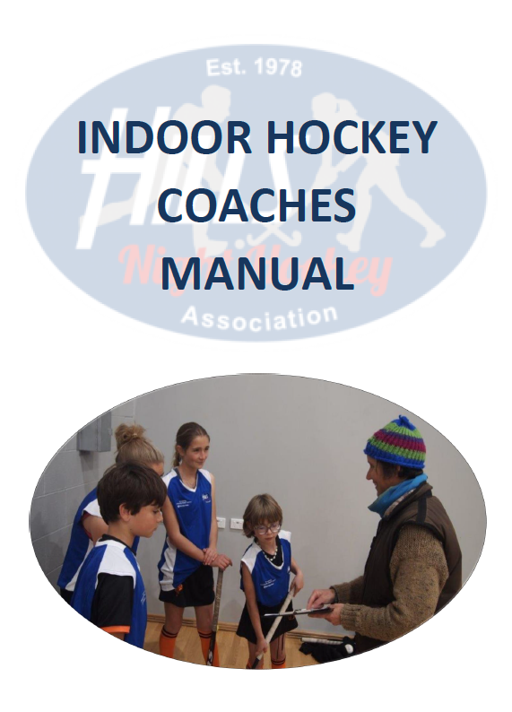
Purpose
This briefing is for new and experienced Coaches to improve Player skills and game tactics. It covers the equipment, rules, individual skills and basic team structures.
It is not a substitute for undertaking accredited coaching courses but to assist Parents and Players who are requested to coach and organise a team.

Slide 4

Role of the Coach
Primary Responsibility
The Coach is responsible for the management of their designated team in accordance with the Hills Night Hockey Association’s code of conduct.

Slide 5
Role of the Coach
Code of Conduct
1. Treat all Players with respect at all times.
Behave in a sportsman like manner at all times to other Coaches, Officials, Players and Spectators.
Place the safety and welfare of the Players above all else.
Avoid situations that may lead to a conflict of interest.
Be courteous, respectful and open to discussion and interaction.

Slide 6
Role of the Coach
Code of Conduct
Make no detrimental statements in public in respect of the performance of any Match Officials or Umpires.
Promote a climate of mutual support amongst the Players. Encourage Players to respect one another and their worth within the team.
Encourage and facilitate Players’ independence and responsibility for their own behaviour, performance, decisions and actions.

Slide 7
Role of the Coach
Code of Conduct
Determine, in consultation with the Player, what information is confidential and respect that confidentiality.
Avoid situations with your Players that could be construed as compromising.
Provide a safe environment for training and competition.
Recognise individual differences in Players and cater to these as best you can.

Slide 8
Role of the Coach
Code of Conduct
Refrain from using obscene, offensive or insulting language and/or making obscene gestures which may insult Players, Officials or Spectators.
Refrain from physical abuse.
Comply with the Association’s Working with Children requirements.

Slide 9
Role of the Coach
Key Roles
• To ensure the Players, Parents and other Spectators behave in accordance with the HNHA code of conduct.
• To ensure Players have the skills and competencies necessary for their age group so they can continue to develop in the future.
• To ensure the Players display sportsmanship in acknowledging the opposition prior to push back, and cheering the umpires and opposition at the final whistle.
• To attend training and games regularly or appoint alternatives in the event of non-attendance.

Slide 10
Role of the Coach
Key Roles
• To appoint volunteers to roles to assist the Coach, such as Team Managers.
• To acquaint yourself with any medical conditions Players may have and ensure appropriate treatment is available if necessary.
• To ensure Players do not enter the training track or playing field without shin guards and mouthguard, and that the Goal Keeper has effective equipment.
• To ensure match cards are completed and returned to the Arena office.

Slide 11
Role of the Coach
Helpful Hints
Be tough with Players and Parents early if necessary – it will help later in the season.
Be respectful towards the opposition Players and Supporters and the Umpires – your leadership and attitude will greatly influence your own team.
In the event of unruly behaviour by our Players or Parents, take control early.

Slide 12
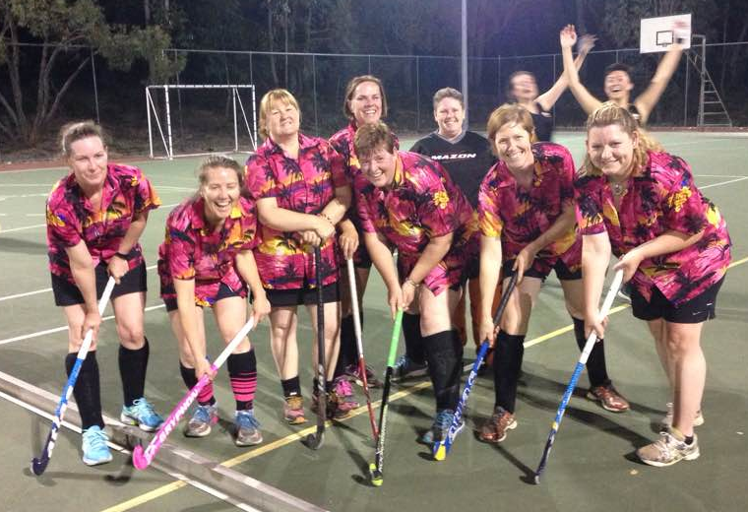
Role of the Coach
Helpful Hints
The teaching of basic roles, basic game plans and game strategies needs to be taught in conjunction with skills at an appropriate age. Coaches should endeavour to introduce to young Players a variety of skill sets.
Have fun!

Slide 13
Commandments of Coaching
EVERY Player should enjoy playing and training.
Be 100% positive.
Be Clear and Simple.
Stick to the one point.
Always be prepared. Sessions should be planned in advance. Coaches should not stand around thinking “What will we do next”.
Coaches should be punctual and require Players to follow the example set.

Slide 14
Commandments of Coaching
Be approachable. Coaches should listen to Players concerns, questions, statements. EVERY Player should receive a degree of individual attention at EVERY training session.
Be active. Players should be kept active as much as possible. Coaches should set the example by being “busy” all the time.
Coaches should instill an attitude of fairness and sportsmanship in all Players by word and deed.

Slide 15
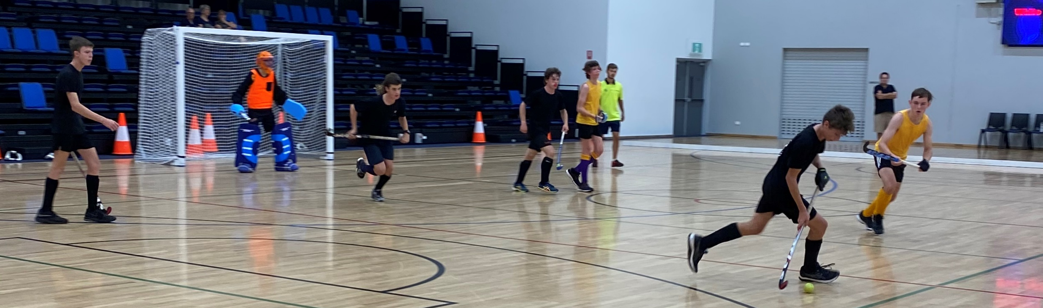
Commandments of Coaching
Players who are coping easily should be extended. Players should be encouraged to practice at home.
By the end of the season EVERY Player should have had at LEAST ONE problem area of their game play and/or skills identified and corrected.

Slide 16
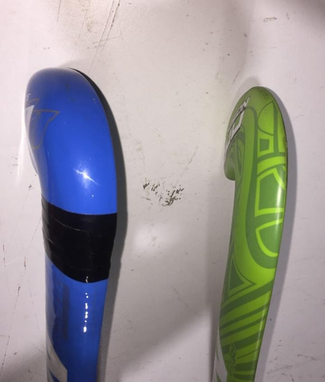
Basic Equipment
  Balls
  Indoor hockey balls are smooth (normally yellow) and are a different weight to field hockey balls
  Sticks
  Indoor sticks have the mass at the stick head is reduced (not required for hitting).
  Reduced “sweet” spot so the ball can be trapped dead on indoor sticks.

Slide 17
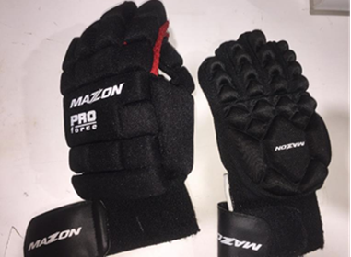
Basic Equipment
  Gloves
  It is recommended that after 5/6s, that as a minimum, a left hand glove be worn by all field Players with a preference for an indoor glove. The difference between most field gloves and indoor gloves is that the thumb is protected. The left thumb is exposed when using the left side back stick block tackle.

Slide 18
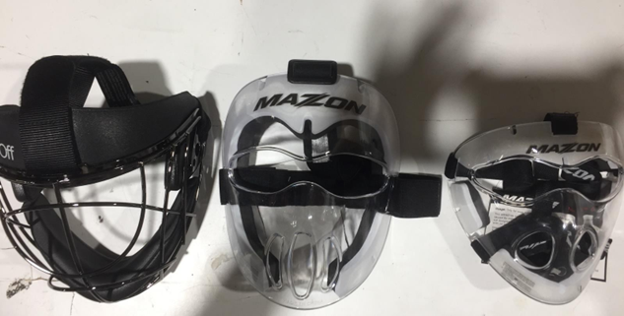
Basic Equipment
  Masks
  The use of face masks at penalty corners is highly recommended for all defenders involved above 5/6s. The major problem is not the flick (it can cause injury) but the deflection from a stick at short range or deflection off the keeper’s equipment.

Slide 19
Basic Equipment
  Footwear
  For the Arena courts Players MUST WEAR Non Marking footwear. Any normal sports shoes that support the foot are recommended. NO tags or metal cleats are allowed on the playing surface.
  Mouth Guards and Shin Pads
  If a Player feels safe they play better and shin pads and mouth guards reduce injury. They are compulsory for all field Players in all games.
  Goal Keeper
  HNHA requires a fully kitted Goal Keeper (excluding Senior Men or Women).

Slide 20

Indoor Specific Rules
  International Hockey
  Federation
https://www.fih.hockey/about-fih/official-documents/rules-of-hockey

Slide 21
Differences to Field Hockey
  5 field Players and a Goal Keeper not 10 Players and a Goal Keeper.
  NO hitting allowed, including slap hits. (Action of stick on the ball must start low and remain low).
  Side boards are used so the ball does NOT go out over a sideline.
  3 metres is used rather than 5 meters in field.
  Ball cannot be lifted except for a shot on goal. This includes deflections of balls already in the air. If coming off the Goal Keeper/defender, the ball MUST be brought to ground first and then played. If no opposition Players are in close, the ball can rise 100 mm (height of the side board).

Slide 22
Differences to Field Hockey
  Only the stick and your feet can be on the floor. (The hands holding on to the stick are considered part of the stick). This rule does NOT apply to Goal Keepers within the circle.
  Ball cannot be pushed into Players who are down low. Known as a drill and is considered dangerous play.
  Defenders on penalty corners must run on the opposite side of the net to the injector. Goal Keeper is the only Player in the net on a corner.
  If a defender breaks on a short corner they go to the opposition’s circle.
  Any defender not behind the backline on a penalty corner goes to the opposition’s circle.

Slide 23
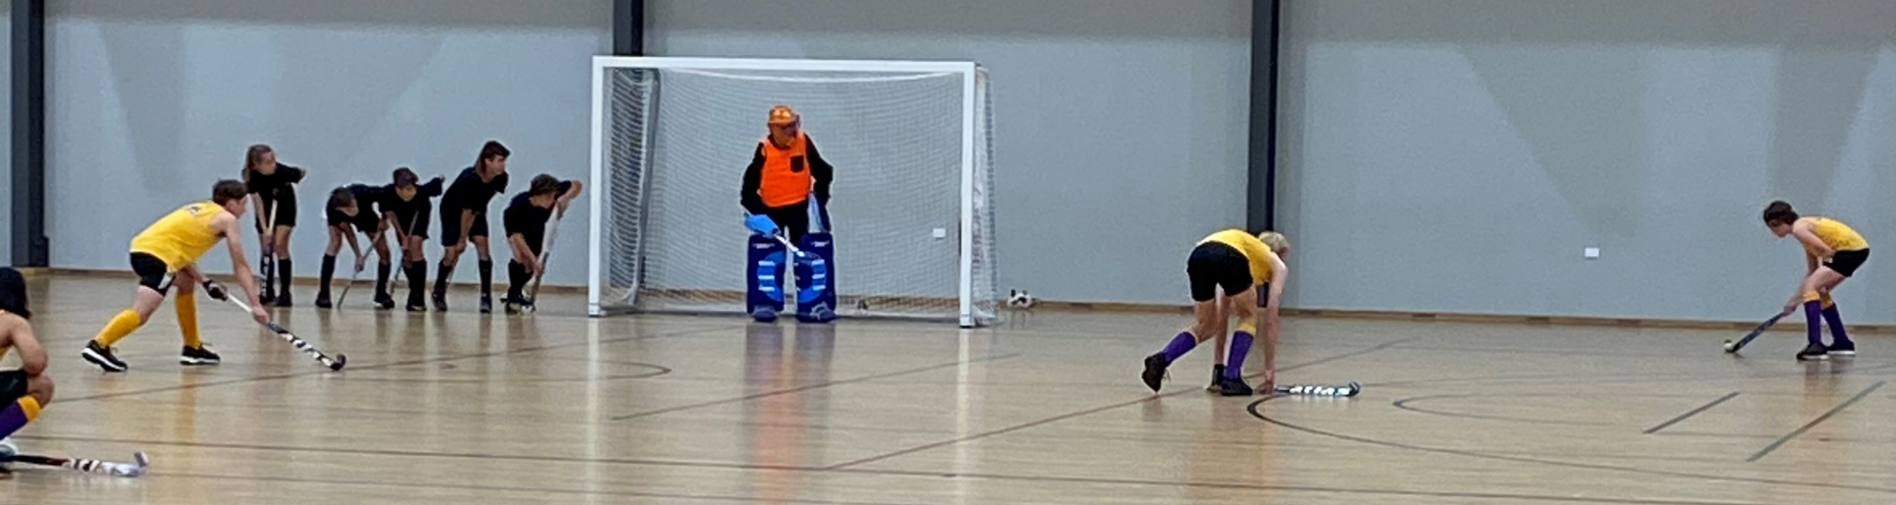
Differences to Field Hockey
  Half way line is used for long corners (not 25 Yard line).
  In the attacking half free hits cannot go directly into the circle (this includes long corners).

Slide 24
Differences to Field Hockey
  Obstruction in relation to
      a. Balls trapped against side board
      b. Pushing / bull dozing through
      c. ‘trapping’ Players with the ball in the corner pockets

Slide 25
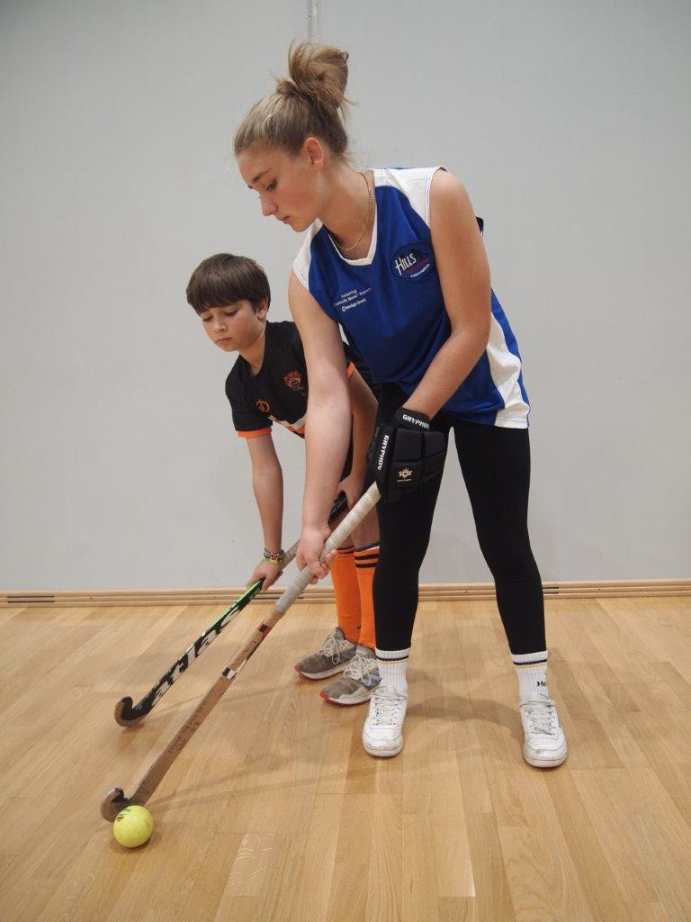
Player Basics
Stick Grip
Pushing
Goal Shooting
Trapping
Running The Ball
Passing
Goal Keeping

Slide 26
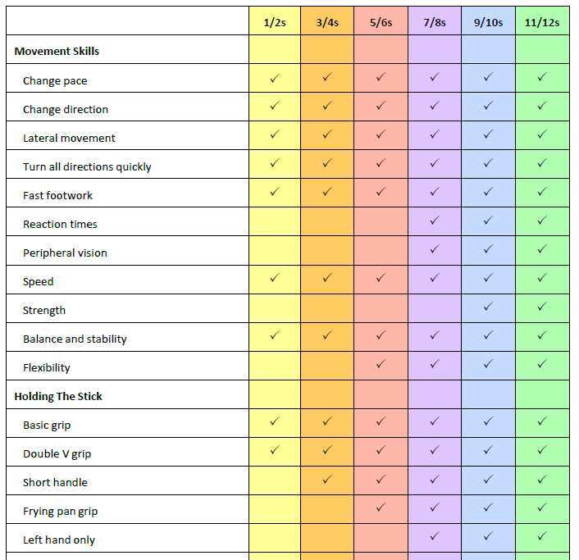
Age Group Outlines
Age Characteristics
Training Tips
Emphasis
Skills Standard
Game Plan

Slide 27
Training Session Planning
Coaches should have a PREPARED, WRITTEN session plan before any training session. This does not mean the coach can’t deviate from the plan if circumstances require it.
The plan should incorporate basic skills, revision of skills and areas identified as needing attention based on previous trainings or match play.
Players should be involved in the planning phase especially regarding team rules, style of play etc so that there is a sense of shared ownership.

Slide 28


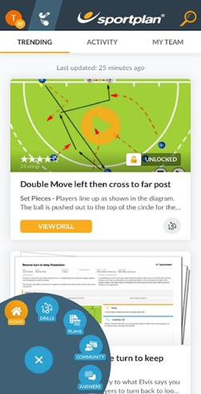
Training Session Planning

Slide 29
Drills

Slide 30
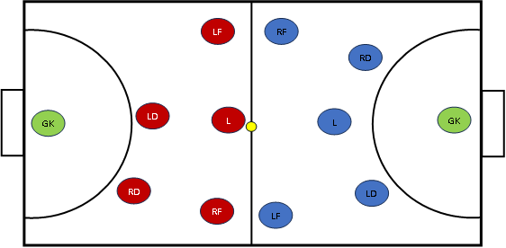
Basic Position Play

Slide 31
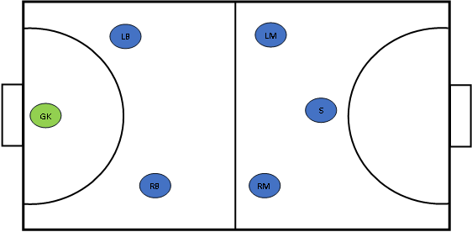
Single Striker

Slide 32
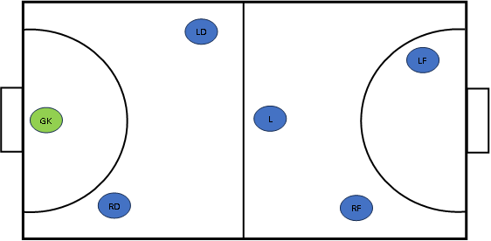
Staggered File

Slide 33
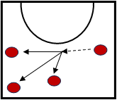
Set Plays
Getting Ball Out Of Defence
Blocking In Opposition Frees
Free Hit Outside Circle
Two On Two

Slide 34
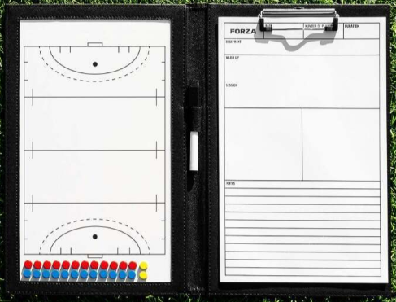
Match Checklist for Coaches
Pre-Match
1. Communicate match objectives
First Half
  Look at Opposition
  Look at Our Team
  What can be changed?
  Put together half time report
Second Half
  1. Utilise alternative tactics
  2. Make substitutions
  3. Revisit match objectives

Slide 35
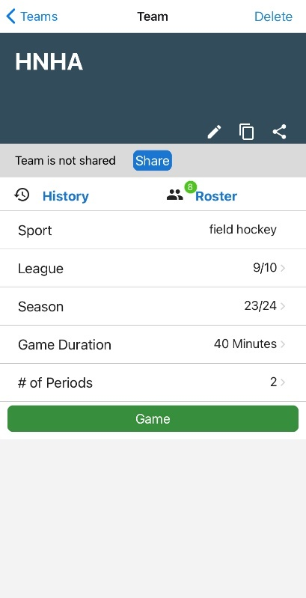
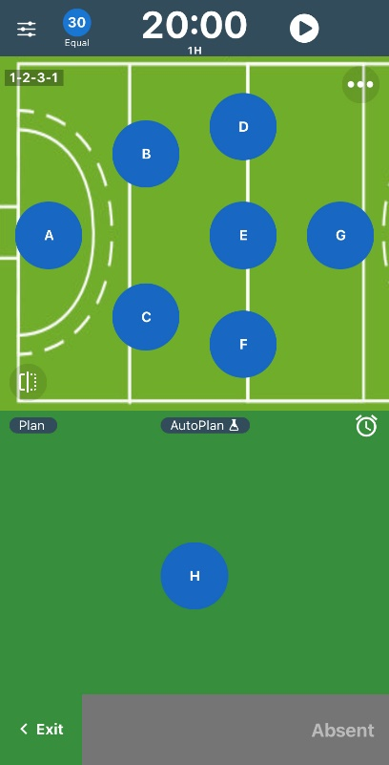

Game Management
SubTime is a free app that has a field hockey set up that can be modified to suit indoor hockey.

Slide 36
Recruitment
Any Coach is only as good as the Players in the team. Therefore, it is imperative that there is a recruitment program that attracts “athletes” into the team. The more Players within the Association the better the competition will be.
Recruitment Programs
Bring A Friend Day
Letter Box Drops
Parent Information Nights
Play With The Stars Day

Slide 37

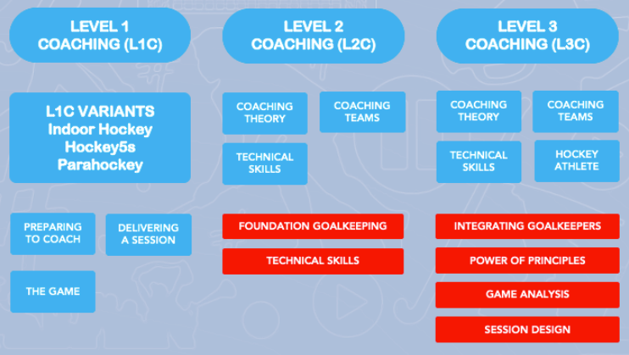

Slide 38
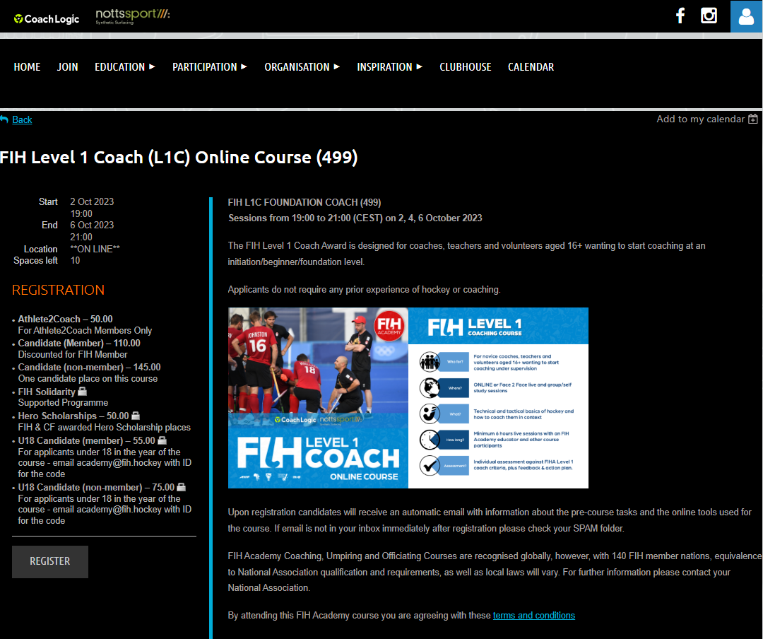
https://fih.wildapricot.org/event-5190568

Slide 39
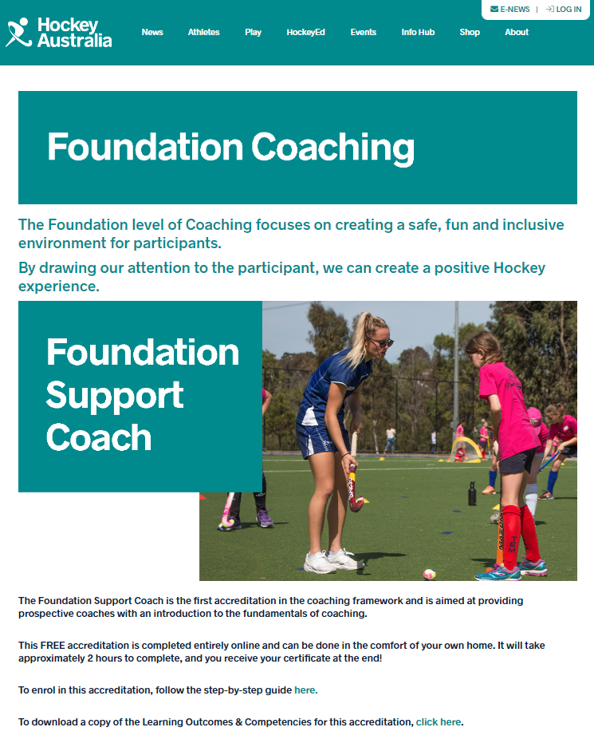
https://www.hockey.org.au/hockey-ed-accreditations/foundation-coaching/

Slide 40

https://www.hockeywa.org.au/participate/cen/

Slide 41

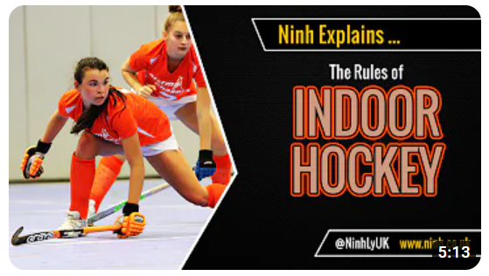
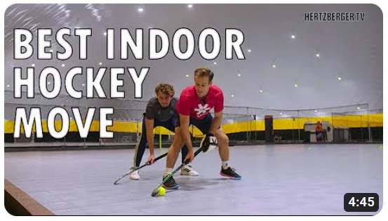

Slide 42
Resources

Slide 43
Coaching
Coaching is a rewarding, challenging activity.
As Coaches we are an integral part of the game.
Enjoy your Coaching!
Good luck with your matches!

